Slide 1
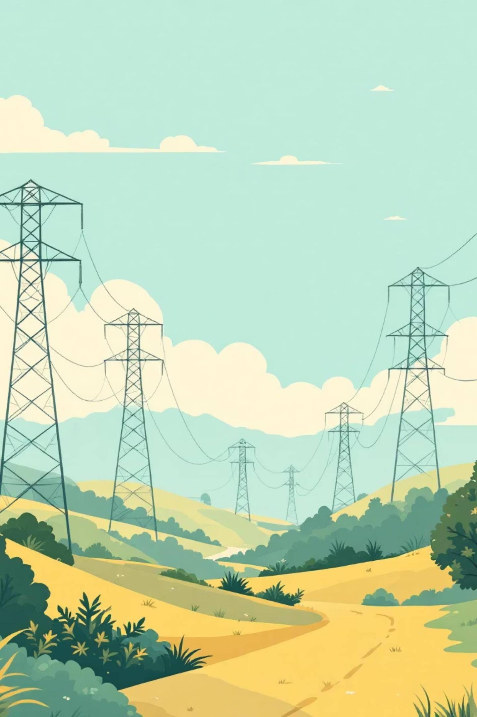
Time Series Analysis of Electricity Consumption and Demand across India
2018–2028: Forecasting Energy Trends
By
Vyshak - 242626025
Danial - 242626035
Dhanesh - 242626061

Slide 2
Introduction
India’s electricity demand is rising rapidly due to population growth, urbanization, and industrialization. The India Electricity Consumption Dataset provides day wise data data on generation, capacity, and emissions. Analyzing this dataset helps identify consumption patterns, seasonal trends, and supports forecasting future electricity demand for better energy planning and management.

Slide 3
Literature Review
The Energy and Resources Institute (TERI) Project: Analysing and Projecting Indian Electricity Demand to 2030 Researchers: Thomas Spencer and Aayushi Awasthy Focus: Sector-wise electricity demand projections (agriculture, industry, services, residential), using econometric and end-use analysis.
Ministry of Statistics and Programme Implementation (MoSPI) Publication: Energy Statistics India 2025 Focus: National-level data on electricity generation, consumption, transmission losses, and renewable energy trends.

Slide 4
Objectives
Forecast energy demand for India
Prediction of energy consumption over the year
Using statistical metrics like RMSE, MAE, and AIC to ensure reliability and accuracy

Slide 5

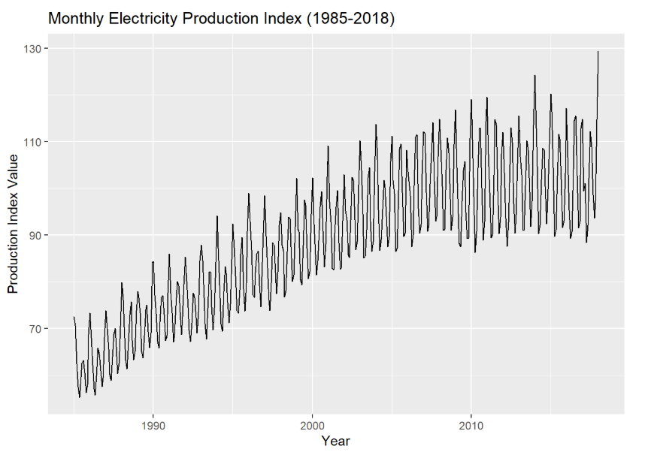
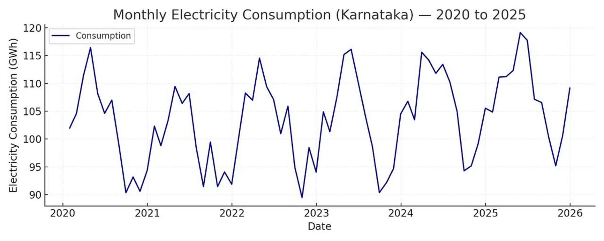
Trend and Seasonality Analysis of Monthly Electricity Production
The graph depicts a steadily growing electricity production index with strong seasonal patterns and periodic fluctuations, reflecting increasing energy demand and consistent seasonal consumption cycles from 1985 to 2018

Slide 6

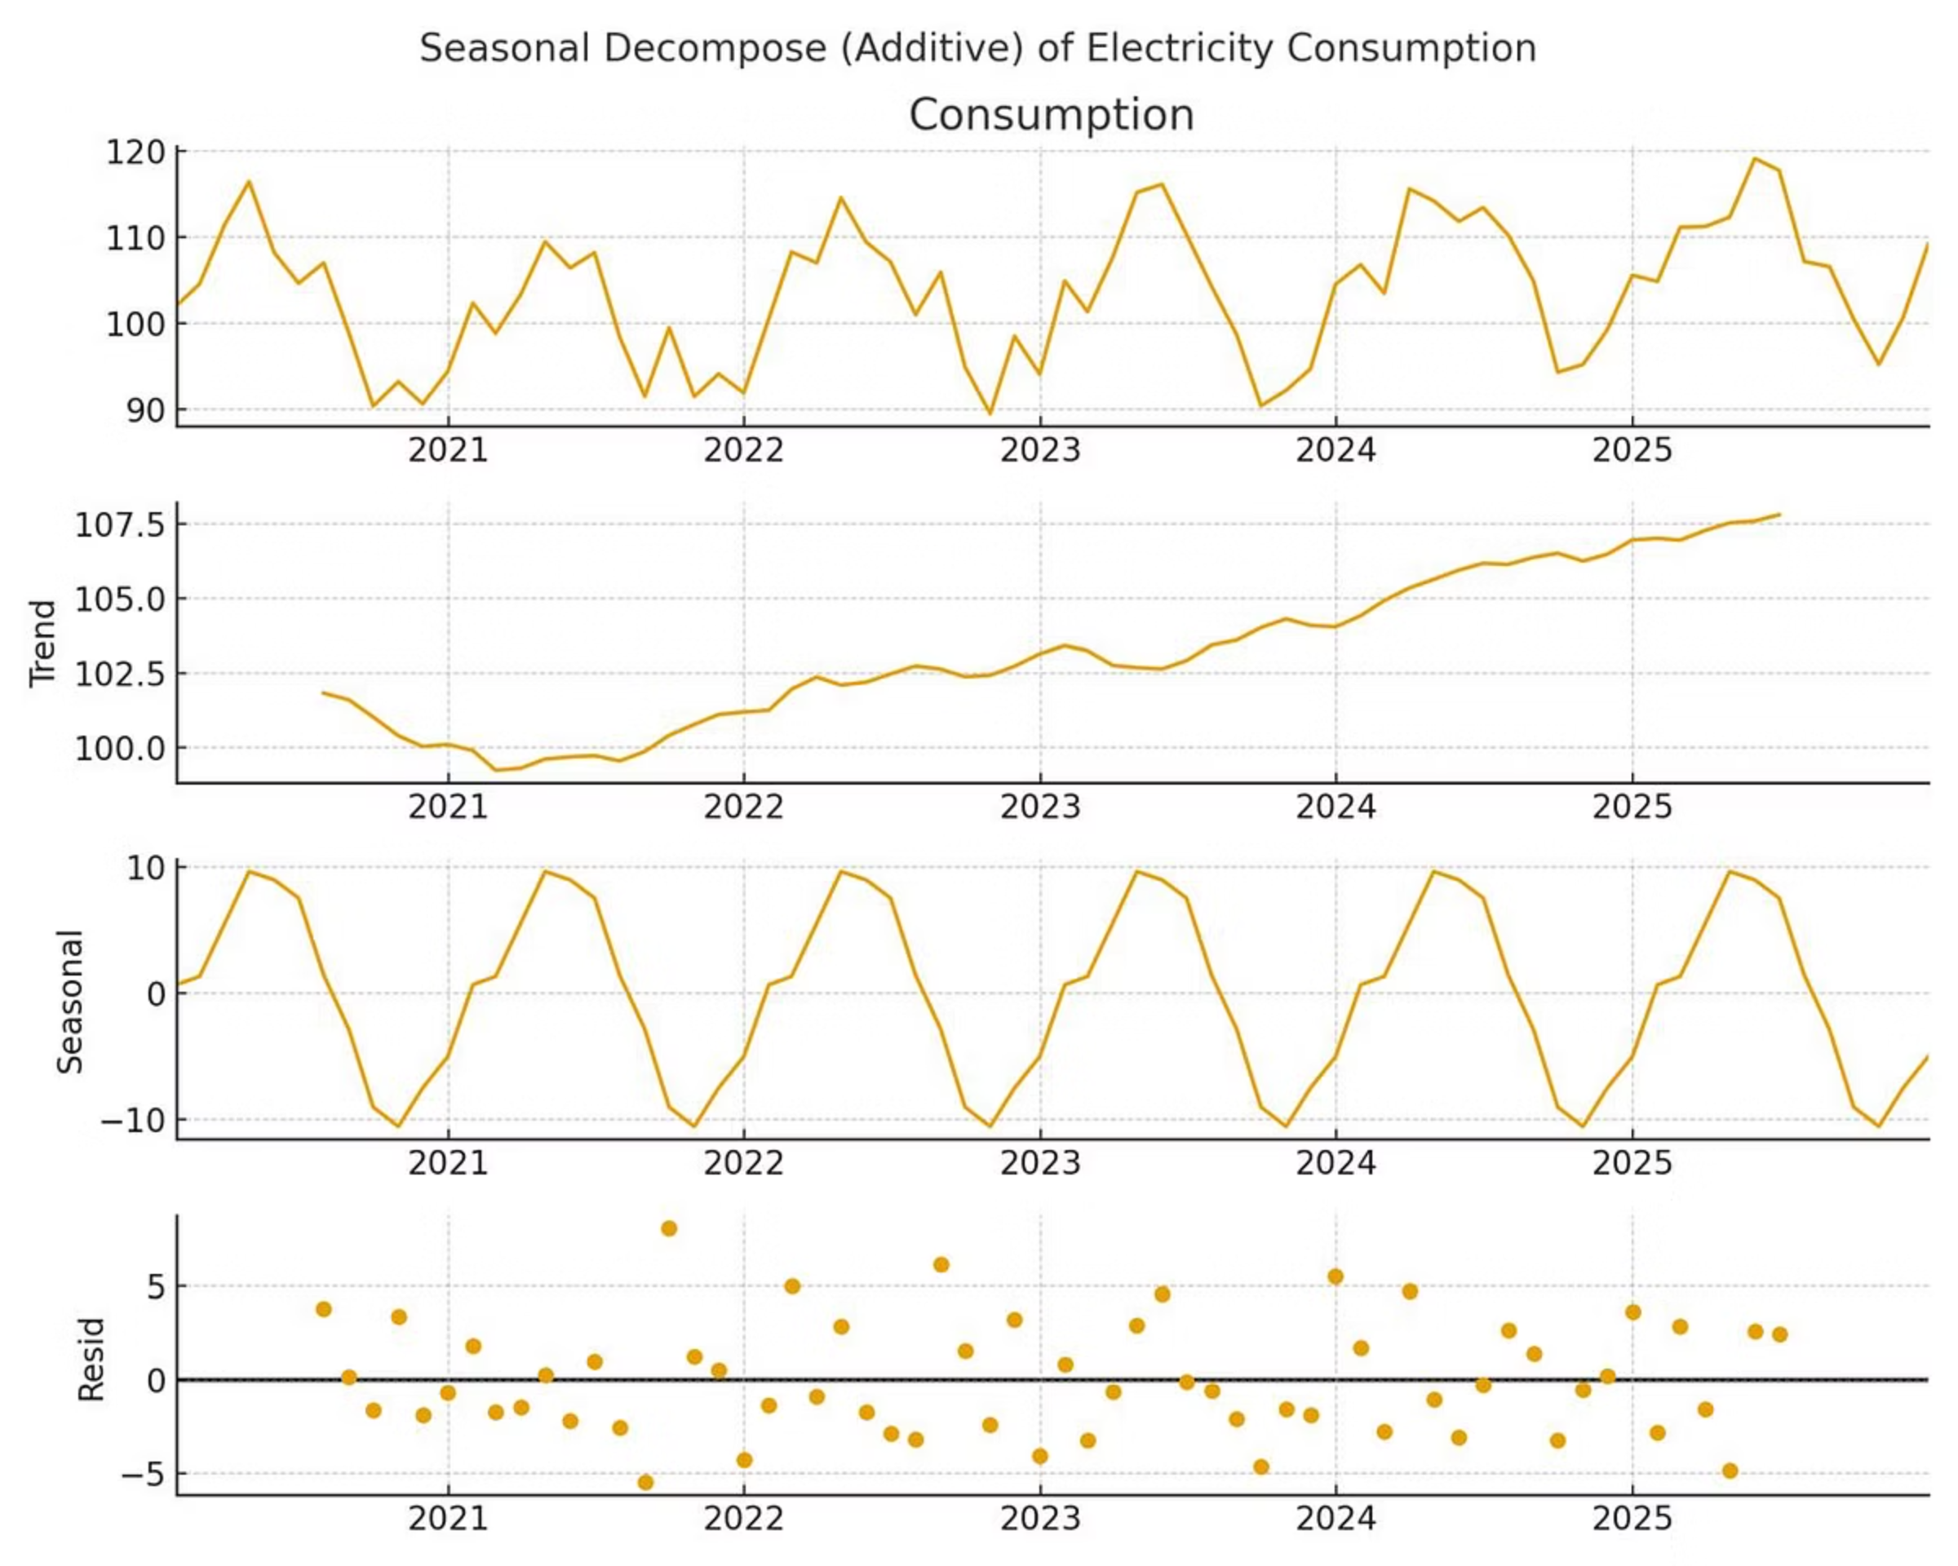
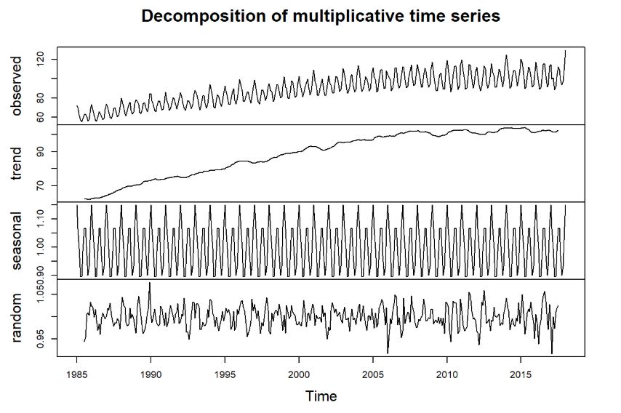
Decomposing the Time Series
Breaking down electricity data into its fundamental components reveals the hidden structure driving consumption patterns. Each element tells a distinct story about energy demand across india
It clearly shows a rising trend over time with strong seasonal fluctuations repeating every year.
Trend
Seasonality
This indicates consistent growth in electricity production for about 25 years, possibly stabilizing after 2010.
The seasonal pattern repeats consistently across the years — meaning the seasonal effect remains stable.
Residuals
This represents random shocks like sudden changes in demand, outages, or economic events.
some fluctuations become slightly more pronounced, indicating increased unpredictability.
.

Slide 7

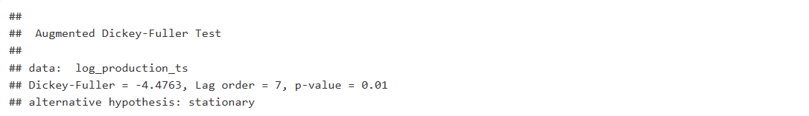
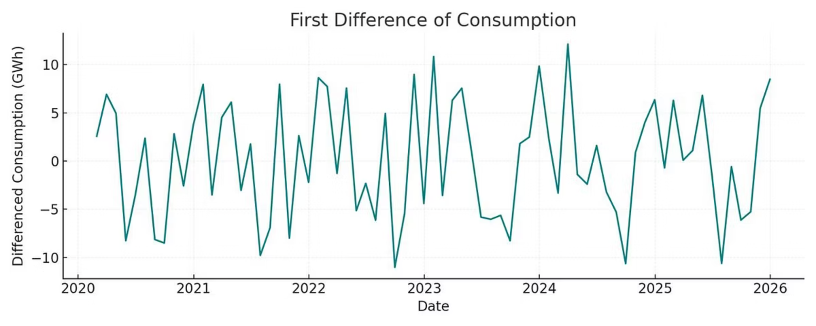
Testing for Stationarity: The ADF Test
Stationarity is essential for time series modeling. The Augmented Dickey-Fuller (ADF) test determines whether the data behaves consistently over time, enabling reliable forecasting.
1
Adf-test values
Test statistic (Dickey-Fuller): –4.4763
p-value: 0.01
Alternative hypothesis: Stationary
2
After Differencing
The Augmented Dickey-Fuller test indicates that the log-transformed electricity production time series is stationary (p = 0.01). Hence, it is ready for further time series modeling SARIMA forecasting.

Slide 8
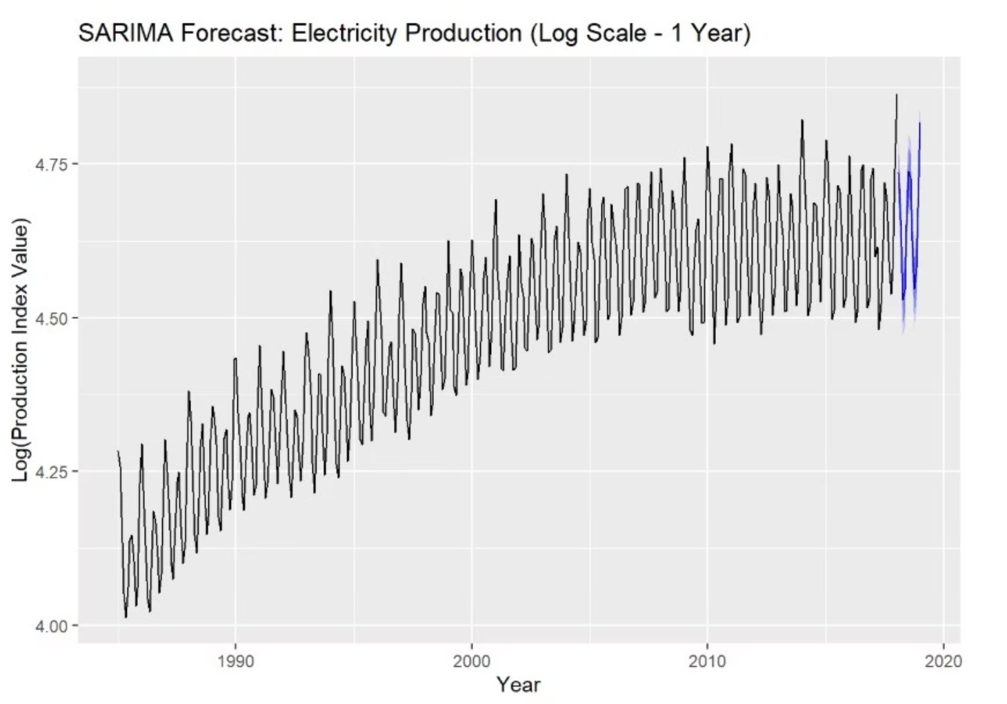
SARIMA Model: Capturing Trend and Seasonality
Model Architecture
SARIMA (Seasonal ARIMA) combines autoregressive, integrated, and moving-average components with a seasonal layer. The tested configuration—SARIMA(2,1,2)(1,1,1,12)—captures both annual cycles and underlying growth trends simultaneously.
Why SARIMA? Unlike standard ARIMA, it explicitly models the 12-month seasonal pattern in electricity consumption, ensuring forecasts respect recurring annual demand patterns.

Slide 9
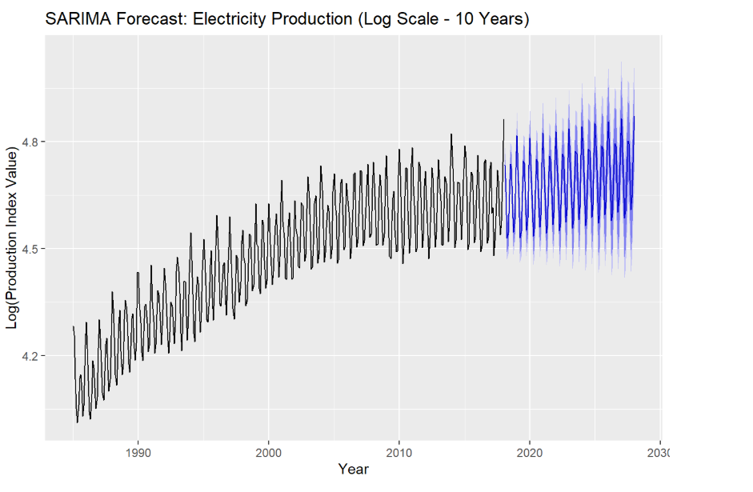
Overall upward trend: The index is rising steadily every year — for example,
January goes from 113.87 (2018) to 130.49 (2028).
December goes from 113.02 (2018) to 120.42 (2027). This means electricity production is consistently increasing over time, showing economic and industrial growth.
Seasonal pattern:
Each year, production is lower around March–April and higher around June–July.
This shows a repeated seasonal cycle — electricity production likely peaks in the summer months (when demand is high) and dips in spring.
Stable growth: The increase from year to year is smooth and gradual, not sudden.
This indicates stable and predictable growth in electricity generation over the years.

Slide 10

Evaluating Model Performance
Accuracy metrics demonstrate the SARIMA model's reliability for forecasting INDIA electricity demand.
Interpretation
Metric
Value
Mean Absolute Error (MAE): Interpretation: On average, the model's prediction for the electricity production index was off by about points when compared to the actual index value.What it means: The MAE is straightforward—it tells you the typical magnitude of the error in the units of your forecast. A value of $4.98$ means your forecast is usually within $4.98$ index points of the true historical value.
MAE (Mean Absolute Error)
3.0306
.
RMSE(Root Mean Square Error):
4.0731
Root Mean Square Error (RMSE): Interpretation: The RMSE is slightly higher at points, indicating that the model made some larger, less frequent prediction errors during the 2-year testing period.What it means: The RMSE penalizes large errors more heavily than MAE (because the error is squared). The fact that RMSE ($6.54$) is noticeably higher than MAE ($4.98$) suggests your model handled most predictions well, but struggled significantly during a few critical periods (like a sudden unseasonal surge or dip in production).

Slide 11
Conclusion on Reliability:
Since the electricity production index typically runs in the 80 to 130 range, an MAE of $\sim 5$ points suggests the model is reasonably reliable for capturing the general trend and seasonality, but requires further refinement to minimize those few larger prediction errors highlighted by the RMSE.

Slide 12
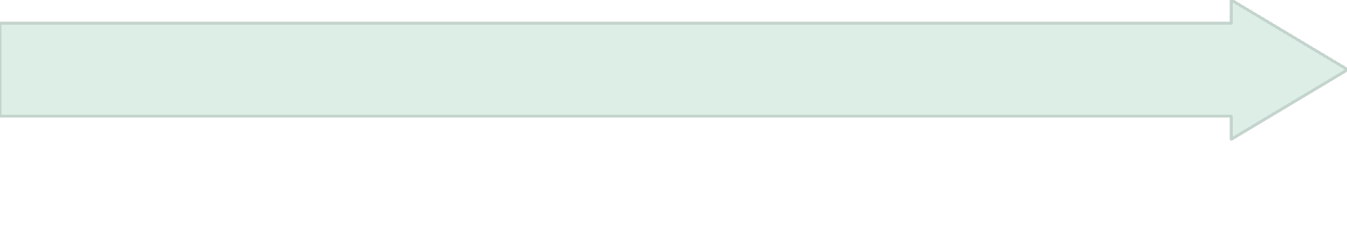

Key Insights and Strategic Implications
Predictable Seasonality
Growing Demand
Recurring annual peaks enable utilities to anticipate and prepare for peak demand periods, optimizing resource allocation.
Electricity consumption exhibits a persistent upward trajectory, reflecting Karnataka's rapid industrialization and urbanization.
Strategic Action
Reliable Forecasting
Energy authorities can use these forecasts for capacity expansion, renewable integration, and demand-side management initiatives.
SARIMA's low error metrics make it a dependable tool for mid-term energy planning and policy development.

Slide 13
Conclusions
Trend Confirmed: INDIA electricity demand rises steadily, driven by economic growth and industrial activity.
Seasonality Captured: Predictable annual cycles enable proactive resource planning and peak-demand preparation.
Model Validated: SARIMA demonstrates strong forecasting accuracy, supporting reliable short-term projections for policy and infrastructure decisions.
This analysis equips energy planners with actionable intelligence for optimizing power generation, distribution, and grid stability across INDIA

Slide 14

Thank You

